Slide 1
Alcohol Enforcement Teams
Overview of program, FY 19 requirements, funding
and outcomes

Slide 2
SC’s Solutions to the Underage Drinking Problem
Passage of the Prevention of Underage Drinking and Access to Alcohol Act of 2007
Creation of local Alcohol Enforcement Teams in the 16 judicial circuits throughout the state expanded from 6 sites
Public education and awareness
  Parent & Students
  Law Enforcement
  Merchants
  Civic & faith-based groups
  Policy makers
Notes:
Look at editing words

Slide 3
SAPT Primary Prevention Underage Alcohol Use Goal
Goal: To reduce underage alcohol use in South Carolina.
  Objectives:
  Decrease past month alcohol use (30 day use) among South Carolina high school students to 26% or less (2015 YRBS-28.4%)
  To reduce the underage alcohol buy rate for the state of South Carolina to12% or less (Fy16 buy rate was 11.1%)

Slide 4
Funding for Environmental Strategies in South Carolina
The Alcohol Enforcement Team efforts have been funded through a combination of federal (SAPT BG/EUDL BG and EUDL Discretionary grants), state and local funds.
Funding levels have varied from year to year and county to county. Some counties have received federal grants to increase the funding available for AET efforts (NHTSA, DFC, SPF SIG).
The highest level provided by the state was $1,600,000 (2008/2009). This level provided $98,000/circuit.
Current level of funding, $640,000 provided by the state (through federal grants) has remained steady since 2010 (with the exception of one year when it declined to $560,000). This level of funding has provided between $35,000-$50,000/circuit-based on population.
Currently the funds provided by the state are used to support coordination, training and incentives (supplies/materials) for law enforcement partners. Funds provided by the state cannot be used to support officer overtime.

Slide 5
Alcohol Enforcement Teams
DAODAS
County Alcohol & Drug Agencies
Local law enforcement agencies
AET Coordinators
State AET Liaison
Underage Drinking Action Group (UDAG)
Circuit Solicitor’s Offices
Community Coalitions
AET Partnerships & Structure
Support Activities (AET Training, Technical Assistance, & Media Efforts)

Slide 6
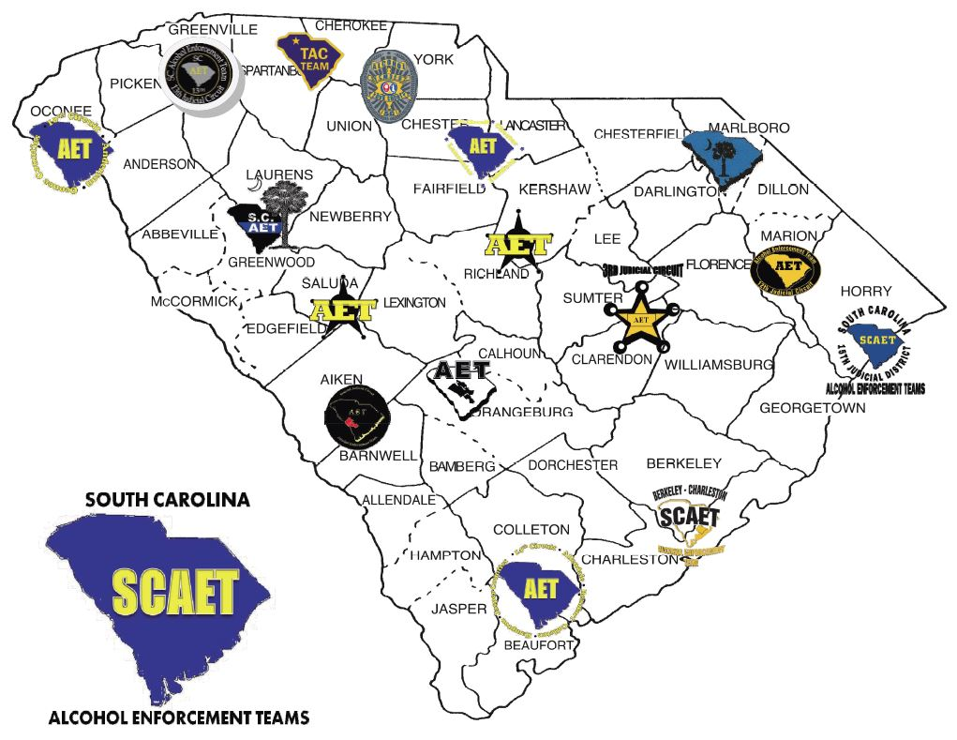
Each Circuit hired a Coordinator
Began extending community relationships and building new ones toward building the teams
All teams formed by October 2007
http://scoutoftheirhands.org

Slide 7
AET Training Currently offered in SC
http://scoutoftheirhands.org/scaet-training.html
2-day AET Training (various modules)
  Environmental Strategies & UD Laws
  Bar Checks
  Controlled Party Dispersals
1-day AET Activities Training (6.5 hrs)
Fake & Fraudulent ID training (5 hrs)
PAS Vr Training (2 hrs)
Public Safety Checkpoints (4hrs)
Public Safety Checkpoints (1/2 hr video)
Special Alcohol Events Management (4 hrs)
Source Investigation (4 hrs)
SCCJA has approved all AET training for CEUs!

Slide 8
AET Activities-Law Enforcement Partners
Non-reimbursable Environmental Strategies (In-Kind)
Alcohol/Tobacco Compliance checks
Public Safety Checkpoints, Saturation or directed patrol
Underage Party Patrols/Dispersals
Fake ID checks in alcohol establishments
Shoulder Tap Operations
Reimbursable Prevention Activities
Underage Drinking Education/Alive at 25
Alternative Events-alcohol-free community events such as after prom parties, basketball tournaments, etc.
Community Events/Presentations on underage Drinking to community groups, parents, students, etc.
Participation in community groups/meetings to plan prevention activities to reduce underage drinking

Slide 9
Allowable and Unallowable Costs for Lead Agency for Circuit
Allowable
Agency staff/contract person salary to include associated cost based on agency's cost allocation plan (fixed charges, office supplies, contractual services, administrative cost, etc.)
Contractual agreements with LE agencies for achieving milestones
Incentives for youth volunteers not to exceed $30.00 in non-cash,
Postage for info dissemination to merchants, parents, local government officials, other LE agencies
Media campaigns (newsletters, newspaper, radio/TV PSA) and printed materials (flyers, brochures, billboards) clearly prevention of underage alcohol use related.
Unallowable
Contractual agreements with LE agencies/agents for time/overtime
Supplies/equipment/materials/apparel even AET-related is not allowable
Media campaigns (newsletters, newspaper, radio/TV PSA) and printed materials (flyers, brochures, billboards) for general prevention or marketing of the agency

Slide 10
Allowable and Unallowable Costs for Other Prevention Agencies in Circuit
Allowable
Office supplies/supplies/media materials used exclusively for AET activities
Postage for info dissemination to merchants, parents, local government officials, other LE agencies
Incentives for youth volunteers not to exceed $30.00 in non-cash
Unallowable
No staff time and other staff-related cost can be charged to the lead agency
No contractual agreements with LE agencies/agents
Supplies/equipment/materials/apparel even AET-related is not allowable

Slide 11
Allowable and Unallowable Costs for Law Enforcement Agencies
Allowable
Fee/charge to circuit lead agency for achieving and documenting milestones. These funds can then be used as follow:
Advanced training for officers on implementing evidence-based environmental strategies to reduce underage drinking
Media materials related to the prevention of underage alcohol use (e.g. billboards, radio and TV ads, flyers, buttons, etc.)
Provide trainings/conferences related to implementing best practice environmental strategies aimed at reducing underage drinking
Officers time for prevention activities that are not enforcement:
Working with the media, providing public presentations/ information dissemination, train other officers on how to conduct effective environmental strategy enforcement operations to reduce underage drinking, etc.), teaching educational programs, participating in community-based process activities and alternative events.
Training of LE personnel:
Monthly workshops, quarterly training, national trainings-Northwest Alcohol Conference, Life Savers, etc., SC Highway Safety Conference, DAODAS/SCAPPA trainings
Speaker fees
Room rental
Materials/handouts
Alternative event activities related to underage drinking prevention:
(e.g. after prom, community events, fairs, etc.)
Unallowable
Time/overtime payments for LE agents to perform law enforcement activities
Supplies/equipment/materials/apparel even AET-related is not allowable

Slide 12
AET Requirements for Lead Agency and Other County Agencies
Lead Agency
  Hire or contract for an AET Coordinator who will serve all counties in the circuit working with county staff and law enforcement as appropriate
  Provide financial and service information to DAODAS
  Ensure the circuit is represented at all State Bi-monthly meetings
  At a minimum, facilitate quarterly meetings with county prevention directors/staff and law enforcement partners throughout the circuit
  Provide documentation to DAODAS the quarterly meetings occurred
Other County Agencies
  Support the overall success of the AET
  Communicate with the AET Coordinator to ensure all AET service data is available and accurately reported in the environmental strategies reporting system, IMPACT and DAODAS
  Work with the AET Coordinator to ensure adequate effort in all circuit counties
  Agency Prevention Directors/Staff will participate in all AET meetings held in the circuit throughout the fiscal year
  Agree to the general direction of the project as outlined in the plan

Slide 13
AET MOA’s/Contracts at the local level
DAODAS does not need for the lead agency to submit copies of each MOA/contract for FY19.
These documents will be reviewed as DAODAS comes on financial or programmatic site visits and/or as requested by DAODAS throughout the fiscal year.
Ensure the lead agency has valid agreements in place for both financial and programmatic aspects of the program.
Contracts must be in place if agencies are receiving AET funds
A sample sub-contract shell has been provided to the lead agency from DAODAS

Slide 14

Outcomes in Reducing Underage Drinking in SC

Slide 15
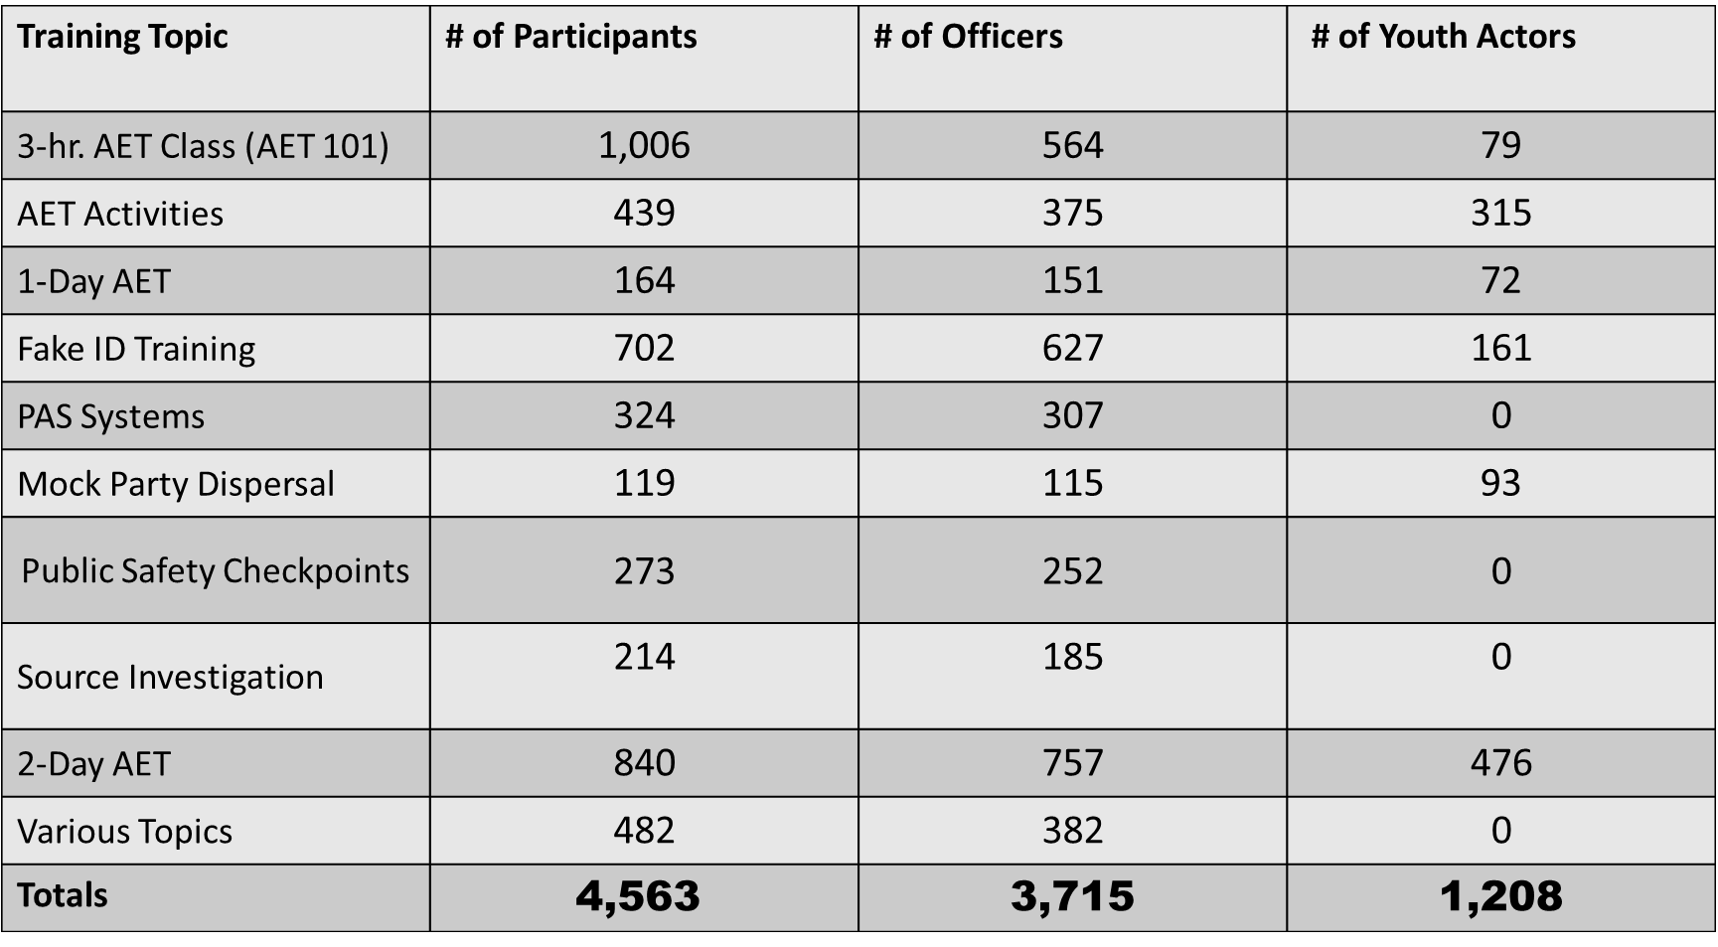
Capacity Building - AET Training participation
Training Topic | # of Participants | # of Officers | # of Youth Actors
3-hr. AET Class (AET 101) | 1,006 | 564 | 79
AET Activities | 439 | 375 | 315
1-Day AET | 164 | 151 | 72
Fake ID Training | 702 | 627 | 161
PAS Systems | 324 | 307 | 0
Mock Party Dispersal | 119 | 115 | 93
Public Safety Checkpoints | 273 | 252 | 0
Source Investigation | 214 | 185 | 0
2-Day AET | 840 | 757 | 476
Various Topics | 482 | 382 | 0
Totals | $$\text{4,563}$$ | 3,715 | 1,208
Training held in 43 of 46 SC counties since Oct. 2007

Slide 16
FY2008 – FY2017 Enforcement Numbers
* July 1, 2007 through June 30, 2017 (state fiscal years run July 1 to June 30)
Activity | FY2008-2017 | Activity | FY2008-2017
Compliance Checks | 73,943 | Compliance Check Sales | 9,781
Public Safety Checkpoints | 7,477 | Bar checks | 2,901
Saturation Patrols | 2,620 | # of Parties Prevented | 1,522
Party Dispersals | 1,395 | Merchant Education | 16,514
Media Contacts | 2,995 | Shoulder Taps | 313
** Enforcement & Education numbers are collected monthly but FY 2017 numbers are not included in this count

Slide 17
Compliance check operation results represent an almost 63% decrease in the buy-rate in SC!
Notes:
8.6% with 6696 buys in FY 2017

Slide 18
Alcohol Crashes 21+ up 17.3% & < 21 down 32.1%

Slide 19
Outcomes for SC in Reducing Underage Drinking
Survey Item | 2005 | 2017 | % decrease
high school students reported ever drinking alcohol | 71.1% | 57.4% | -19.3%
reported drinking alcohol before age 13 | 25.6% | 15.2% | -40.6%
reported drinking alcohol in past 30 days | 43.2% | 24.0% | -44.4%
reported binge drinking (5 or more drinks in 2 hour time period) in past 30 days | 23.6% | 10.4% | -55.9%

Slide 20
DAODAS Contacts
Michelle Nienhius, Prevention Manager and AET State Coordinator
  (803) 896-1184; mnienhius@daodas.sc.gov
Michael George, AET State Liason
  (803) 479-3628; mgeorge@PIRE.org
Carmen Tate, Grants and Contracts Coordinator
  (803) 896-1143; ctate@daodas.sc.gov

